Slide 1
Perceptual Organization
LiMN Lab

Slide 2
Goal
The hypothesis focuses on the interaction between attention and memory encoding strategies.
Simple auditory features, such as pitch, are hypothesized to be more easily remembered when arranged in sequences.
Complex auditory features, such as syllables or everyday sounds, are hypothesized to be more effectively remembered as individual items.

Slide 3
Original Study
The original study used two types of auditory stimuli: pure tones (pitches) and complex everyday sounds.
Participants were asked to listen to a sequence of these sounds, followed by a pause and then a single sound.
In the present/absent task, participants had to determine whether the single sound after the pause was present or absent in the previous sequence.
In the same/different task, participants listened to a sequence of sounds, a pause, and then another sequence of sounds. They had to determine whether the second sequence was the same as or different from the first one.
Findings indicated that participants performed better at identifying pitches in the same/different task and performed better at identifying everyday sounds in the present/absent task.

Slide 4
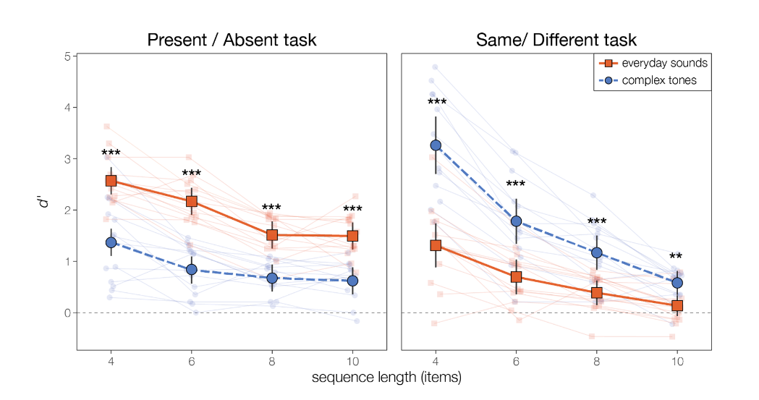
The Original Study result

Slide 5
Concerns
Concern over stimulus complexity differences.
Potential overshadowing of attention's effect.
Recommendation for similar complexity stimuli or adjusted control conditions.

Slide 6
Present & Absent Task
Attend: Pitch
Attend: Syllable
Same & different Task
Attend: Pitch
Attend: Syllable

Slide 7
Present & Absent Task Graph Demo (attend syllable)
BAH
GAH
BOO
DEE
GEE
1st Sequence
BOO
Present
OR
Absent
BEE
Notes:
Let me introduce the tasks, P/A and S/D tasks. In PA, you will be present a sequence of syllables and pitch pair, then a single syllable pitch pair. Your tasks is to attend whether the pitch or syllable is present or absent in the 1st seq.

Slide 8

Present & Absent Task Audio Demo (attend syllable)
Notes:
This demo you are asked to attend syllable. di bu ge bi da gu -du
absent

Slide 9
Same & Different Task Graph Demo (Attend Pitch)
BAH
BAH
BAH
BAH
BAH
DAH
DAH
DAH
DAH
DAH
1st Sequence
BAH
BAH
BAH
BAH
BAH
DAH
DAH
DAH
DAH
DAH
SAME
OR
BAH
BAH
DAH
DAH
DAH
BAH
BAH
DAH
DAH
BAH
DIFFERENT
Notes:
In SD, you will be present a sequence of syllables and pitch pair, then another sequence syllable pitch pair. Your tasks is to attend whether the pitch or syllable is S or D in the 1st seq. This demo you are asked to attend Pitch.

Slide 10
Same & Different Task Audio Demo (Attend Pitch)
Notes:
This demo you are asked to attend pitch. Pay attention to the beginning of the sequence 1st and 2nd pitches are swapped
different

Slide 11
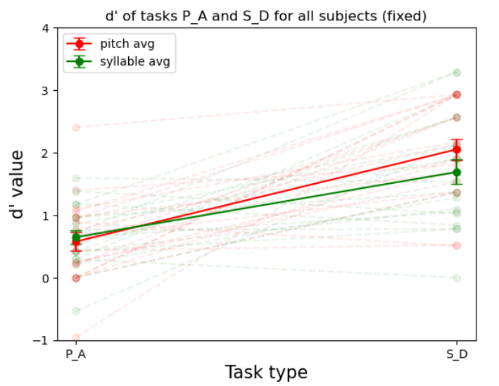
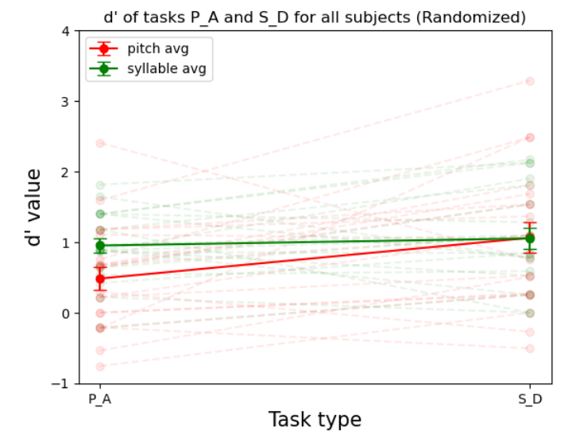
Result with length 6 fixed or randomized condition
Notes:
20 trials per condition

Slide 12
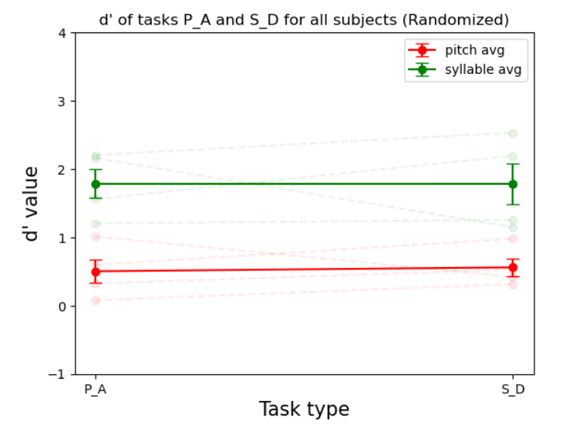
Result with Len 4 randomized task
Linguistic load:
Syllable might be linguistic processing
Everyday sound might be sound object processing (non-linguistic)
Sound complexity
Syllable - energy across harmonic
Everyday sound - broadband energy distribution
Masking
Randomized syllable stronger masking than pitch
Notes:
Another the part is that the fundamental frequence for my stimuli is 200 which is nothing at all. Compare to the musical notes

Slide 13
3 possible ideas
Change the f0 to musical frequency for the pitch variated syllable
Current 200 hz non musical
Musical C 256 hz
More musical thought
Change the stimuli with pitch variated everyday sound (with or without musical f0)
Change keep the same stimuli, but choose another dimension to compare with pitch
Attend: intensity vs pitch
Threshold per people

Slide 14
Purpose
How is perceptual organization shapes working memory, such that features of a single auditory object are stored together (streaming).

Slide 15
Same/Different vs. Present/Absent Tasks
Same/Different
Probes how well items are recalled as a sequence (1 ‘auditory object’)
Present/Absent
Probes how well items are recalled individually (multiple ‘auditory objects’)

Slide 16






Fixed vs. Randomized non-attending dimension
Streaming ↑
Steaming ↓

Slide 17
What do we expect
Attending syllable is easier in P/A than S/D tasks
Attending pitch is easier in S/D than P/A tasks

Slide 18
Single talker vs. Multiple talker
Only syllables changing
streaming ↑
Syllables + talker changing
streaming ↓

Slide 19
Same & Different Task (Attend Pitch): Fixed non-attending dimension (Syllable)
BAH
BAH
BAH
BAH
BAH
DAH
DAH
DAH
DAH
DAH
1st Sequence
.
.
.
BAH
BAH
BAH
BAH
BAH
DAH
DAH
DAH
DAH
DAH
SAME
OR
BAH
BAH
DAH
DAH
DAH
BAH
BAH
DAH
DAH
BAH
DIFFERENT

Slide 20
Same & Different Task (Attend Pitch): Randomized non-attending dimension (Syllable)
BAH
GAH
BOO
DEE
GEE
1st Sequence
.
.
.
BAH
GAH
BOO
DEE
GEE
SAME
DOO
DEE
BAH
GAH
BEE
OR
BAH
GAH
DEE
GEE
DOO
DEE
BAH
GAH
BOO
BEE
DIFFERENT

Slide 21
Same & Different Task (Attend Syllable): Fixed non-attending dimension (Pitch)
BAH
GAH
BOO
DEE
GEE
1st Sequence
.
.
.
BAH
GAH
BOO
DEE
GEE
SAME
OR
BAH
GAH
DEE
BOO
GEE
DIFFERENT

Slide 22
Same & Different Task (Attend Syllable): Randomized non-attending dimension (Pitch)
BAH
GAH
BOO
DEE
GEE
1st Sequence
.
.
.
BAH
GAH
BOO
DEE
GEE
SAME
OR
BAH
GAH
DEE
BOO
GEE
DIFFERENT

Slide 23
Present & Absent Task (Attend Pitch): Fixed non-attending dimension (Syllable)
BAH
BAH
BAH
BAH
BAH
DAH
DAH
DAH
DAH
DAH
1st Sequence
.
.
.
BAH
DAH
Present
OR
DAH
BAH
Absent

Slide 24
Present & Absent Task (Attend Pitch): Randomized non-attending dimension (Syllable)
BAH
GAH
BOO
DEE
GEE
1st Sequence
.
.
.
BAH
DAH
Present
OR
DAH
BAH
Absent

Slide 25
Present & Absent Task (Attend Syllable): Fixed non-attending dimension (Pitch)
BAH
GAH
BOO
DEE
GEE
1st Sequence
.
.
.
BOO
Present
OR
BEE
Absent

Slide 26
Present & Absent Task (Attend Pitch): Randomized non-attending dimension (Syllable)
BAH
GAH
BOO
DEE
GEE
1st Sequence
.
.
.
BOO
Present
OR
BEE
Absent

